Slide 1
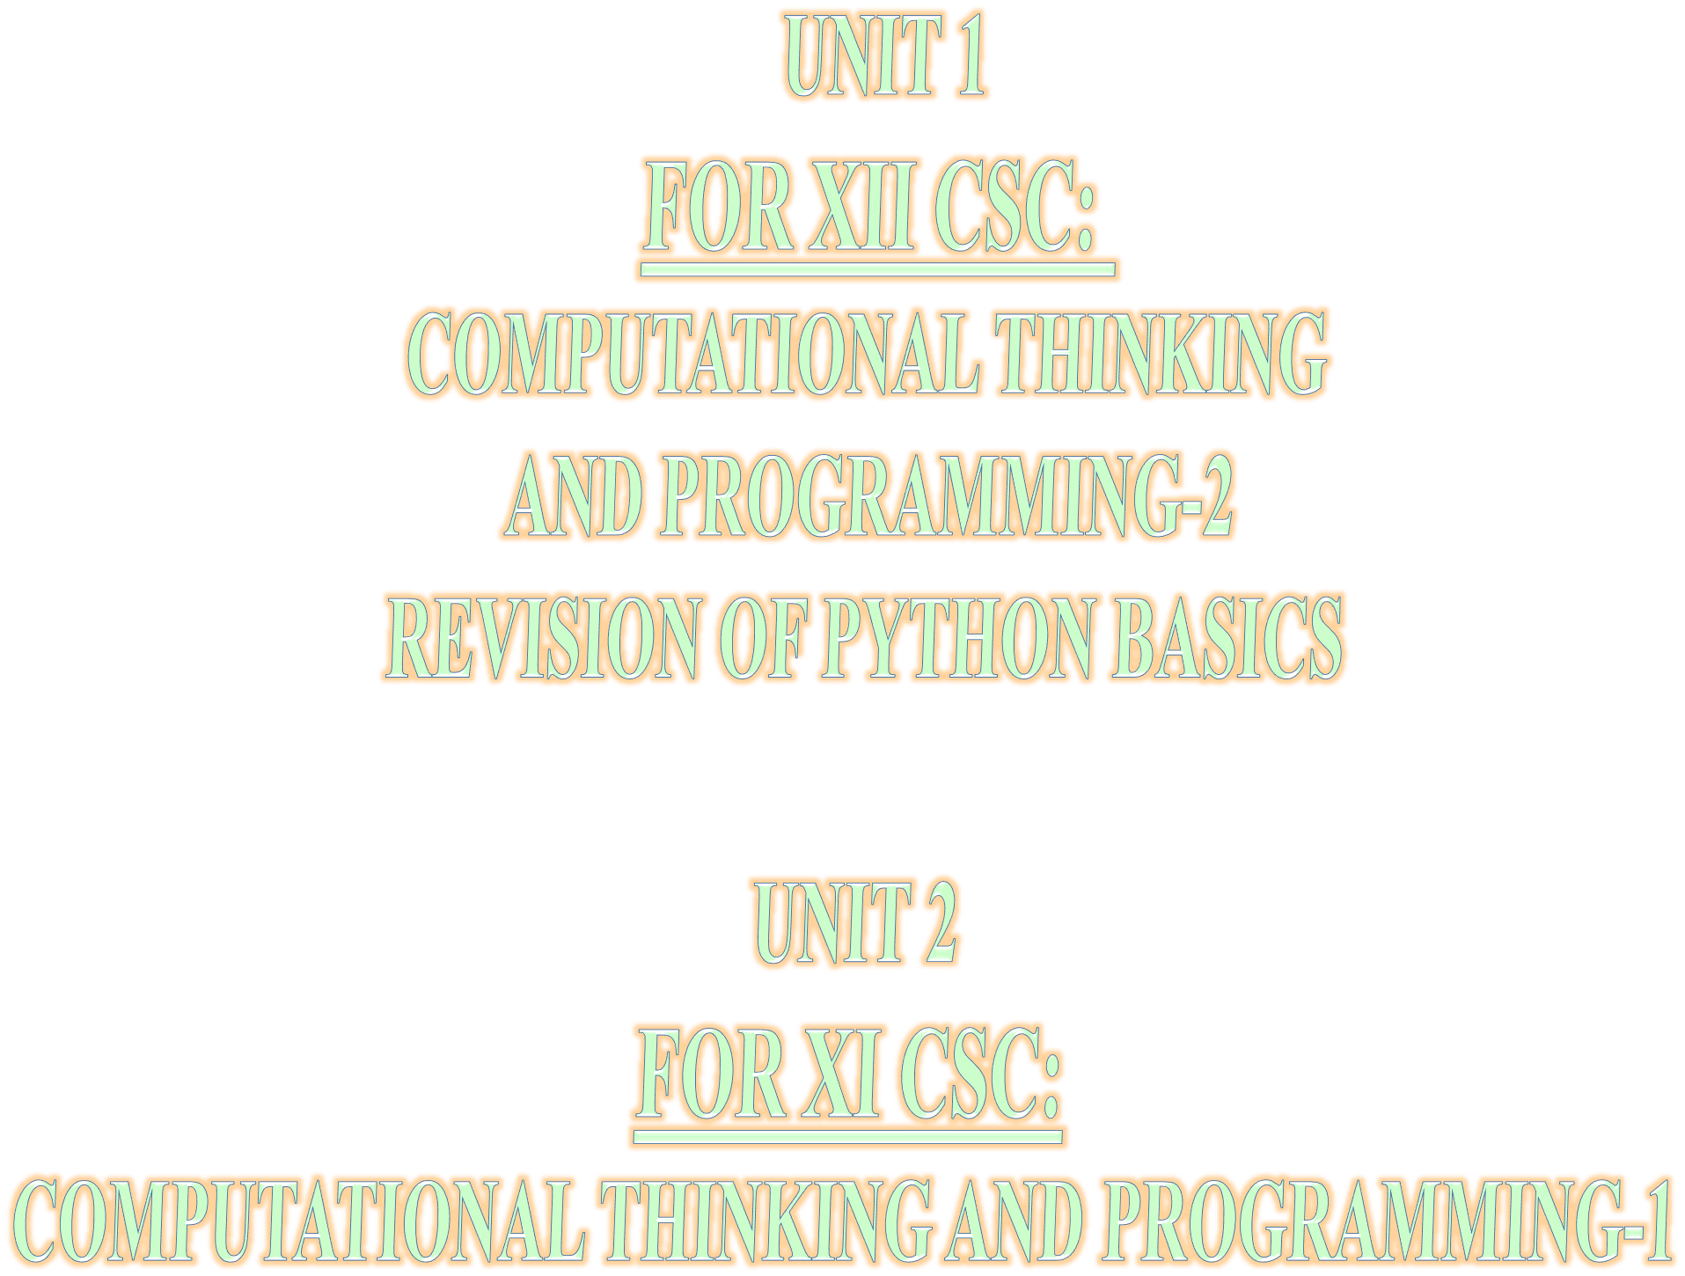

Slide 2






( Learning Outcomes ) ☺
CONTENTS
TUPLES in Python
XI CS 2020-21
→Tuples Introduction: Definition, Creation of a Tuple,
Traversal of a Tuple.
→ Operations on a Tuple – concatenation/joining,
repetition/replication, membership;
→ Functions/methods– len(), tuple(), count(), index(),
sorted(),min(), max(), sum()
→ Tuples Slicing;
→ Nested Tuples;
→ finding the maximum, minimum, mean of values stored in a Tuple
→ Linear Search on a Tuple of numbers
→ Counting the frequency of elements in a Tuple

Slide 3



TUPLE
INTRODUCTION

Slide 4
What is a Tuple ?
CONTENTS
A Tuple is a collection of items which are formed by placing comma-separated values in round brackets, also we say them as parenthesis ()
Each item/element has its own index number.
Index of first item is 0 and the last item is n-1. Here n is number of items in a Tuple.
Tuples are immutable sequences i.e. we canNOT change elements of a Tuple in place.
Tuples can contain values of mixed data types.
→Tuples Intro:
Tuple Definition Indexing in a Tuple Creation of a Tuple Traversal of a Tuple.
→Operations on a Tuple -
→Functions/methods
→ Tuples Slicing;
→ Nested Tuples;
→finding the maximum,
minimum, mean
→ linear search on Tuple
→ counting the frequency

Slide 5
INDEXING in a Tuple
CONTENTS
F O R W A R D I N D E X D I R E C T I O N
→Tuples Intro:
Tuple Definition
Indexing in a Tuple
Creation of a Tuple Traversal of a Tuple
→Operations on a Tuple
→Functions/methods
→ Tuples Slicing;
→ Nested Tuples;
→finding the maximum,
minimum, mean
→ linear search on Tuple
→ counting the frequency
0 | 1 | 2 | 3 | 4 | 5
10 | 20 | 30 | 40 | 50 | 60
-6 -5
B A C K W A R D
-4
-3
-2 -1
D I R E C T I O N
I N D E X
NOTE:-
The index (also called subscript) is the numbered position of a letter in the Tuple. In python, indices begin from
0,1,2,…. upto (length-1) in the forward
direction and
-1,-2,-3,….. (-length) in the backward direction.
where length is the length of the Tuple.

Slide 6
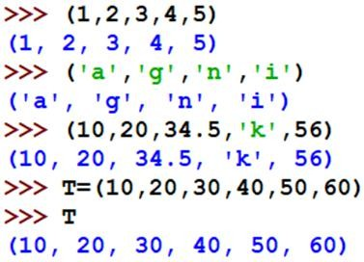
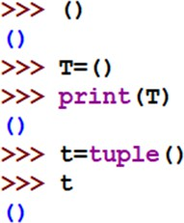
CREATION of Tuple
CONTENTS
→Tuples Intro:
Tuple Definition
Indexing in a Tuple
Creation of a
Tuple
Traversal of a Tuple
→Operations on a Tuple
→Functions/methods
→ Tuples Slicing;
→ Nested Tuples;
→finding the maximum,
minimum, mean
→ linear search on Tuple
→ counting the frequency
 |  | Tuple of numbers created without name Tuple of characters created without name Tuple of mixed data type created without name Tuple of numbers with name T
 | Empty Tuple created without name T Empty Tuple created with name t using funcion Tuple()

Slide 7
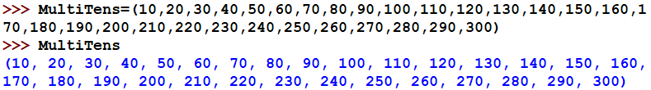

Creation of Tuple contd.(Long Tuple and Nested Tuple)
CONTENTS
→Tuples Intro:
Tuple Definition
Indexing in a Tuple
Creation of a Tuple
Traversal of a Tuple
→Operations on a Tuple
→Functions/methods
→ Tuples Slicing;
→ Nested Tuples;
→finding the maximum,
minimum, mean
→ linear search on Tuple
→ counting the frequency
Creation of a long Tuple with name MultiTens
Creation of a Nested Tuple with name
T that is Tuple inside a Tuple

Slide 8

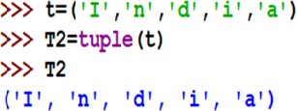
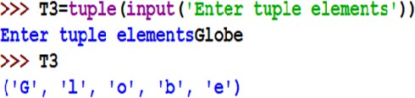
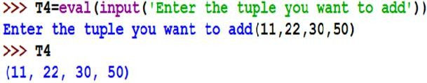
Creation of Tuple from existing sequences
CONTENTS
Creating Tuple from |  | Creating Tuple from tuple
string
→Tuples Intro:
Tuple Definition
Indexing in a Tuple
Creation of a Tuple from string,tuple, Tuple(input()),
eval(input())
Traversal of a Tuple Assign/change values in Tuple
→Operations on a Tuple
→Functions/methods
→ Tuples Slicing;
→ Nested Tuples;
→finding the maximum,
minimum, mean
→ linear search on Tuple
→ counting the frequency
Creating Tuple by taking input from the keyboard(user)
**Note: All the elements are considered as string
Creating Tuple by taking input from the keyboard [using eval()]
]method]
**Note: eval( ) identifies the type by looking at the given
expression

Slide 9
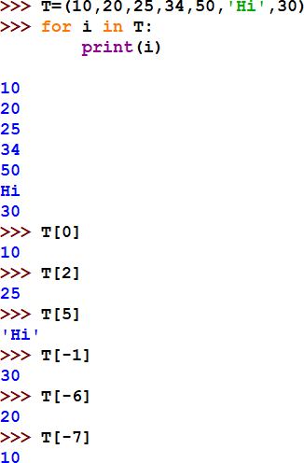
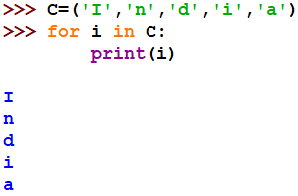
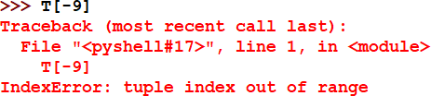
TRAVERSAL of a Tuple
CONTENTS
→Tuples Intro:
Tuple Definition
Indexing in a Tuple
Creation of a Tuple
Traversal of a Tuple
→Operations on a Tuple
→Functions/methods
→ Tuples Slicing;
→ Nested Tuples;
→finding the maximum,
minimum, mean
→ linear search on Tuple
→ counting the frequency

Slide 10

TRAVERSAL of NESTED Tuple
CONTENTS
Enclosing Tuple
→Tuples Intro:
Tuple Definition
Indexing in a Tuple Creation of a Tuple
Traversal of a
Tuple
Assign /change values in
Tuple
Nested Tuple 1
Nested Tuple 2
Note: Denoting Nested elements using Index nos.
N[0] → 10
N[1] → [15,30]
N[1][0]→15
N[1][1]→30 N[2]→ *80,’Mask’,60+
N[2][0]→80 N[2][1]→‘Mask’ N[2][2]→60
→Operations on a Tuple
→Functions/methods
→ Tuples Slicing;
→ Nested Tuples;
→finding the maximum,
minimum, mean
→ linear search on Tuple
→ counting the frequency

Slide 11
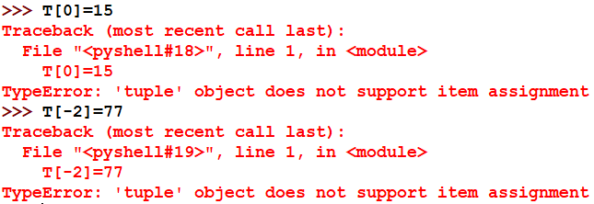
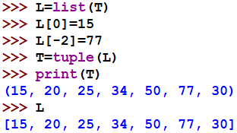
Assign/Change values in a Tuple
 |  | Assigning / Changing values of elements of a Tuple is NOT POSSIBLE.
 | Assigning / Changing values of elements of a Tuple can be done by converting the tuple to a LIST using list() method , changing value of the list and then again converting it to a tuple using tuple() method. In this way, you also get a copy of the tuple in the form of a List. Here, T is the tuple and L is the List.
CONTENTS
→Tuples Intro:
Tuple Definition
Indexing in a Tuple Creation of a Tuple Traversal of a Tuple
Assign /change values in Tuple
→Operations on a Tuple
→Functions/methods
→ Tuples Slicing;
→ Nested Tuples;
→finding the maximum,
minimum, mean
→ linear search on Tuple
→ counting the frequency

Slide 12





Slide 13
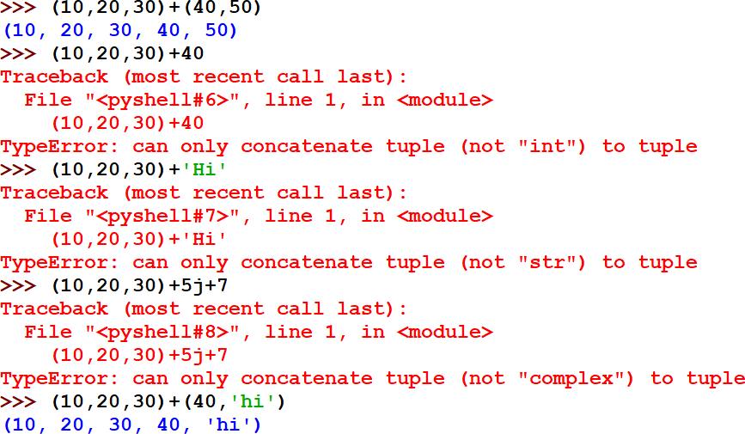
OPERATIONS on Tuple Concatenation
CONTENTS
Tuple CAN be concatenated or
joined with another Tuple
→Tuples Introduction:
→OPERATIONS
ON Tuple
Concatenation/Joining
Repetition/Replication Membership Comparison of Tuples
→Functions/methods
→ Tuples Slicing;
→ Nested Tuples;
→finding the maximum,
minimum, mean
→ linear search on Tuple
→ counting the frequency
Tuple CANNOT be concatenated with a number
Tuple CANNOT be concatenated with a string
Tuple CANNOT be joined with a complex nos.
Concatenation refers to Joining of two objects
Tuple CAN be concatenated or joined with another Tuple

Slide 14
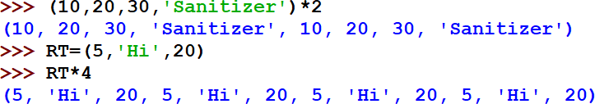
OPERATIONS on Tuple Replication
CONTENTS
→Tuples Introduction:
→OPERATIONS
ON Tuple
Concatenation/Joining
Repetition/
Replication
Membership Comparison of Tuples
→Functions/methods
→ Tuples Slicing;
→ Nested Tuples;
→finding the maximum,
minimum, mean
→ linear search on Tuple
→ counting the frequency
Replication refers to Repetition of objects as it is. Here, in TUPLE we can see NON- VECTORISED operation with a tuple where the entire tuple as a whole is replicated.
NOTE: Vectorised operation, refers to the replication of individual elements of the object.
Replicating the unnamed Tuple two times
Replicating the named Tuple RL
four times

Slide 15


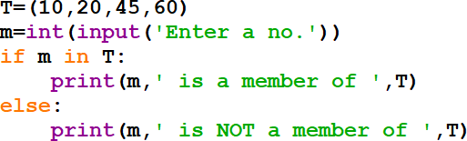
OPERATIONS on Tuple Membership
CONTENTS
Membership operator tests for Membership in a sequence.
Returns Boolean True or False
→Tuples Introduction:
→OPERATIONS
ON Tuple
Concatenation/Joining Repetition/ Replication
Membership in Tuple
Comparison of Tuples
→Functions/methods
→ Tuples Slicing;
→ Nested Tuples;
→finding the maximum,
minimum, mean
→ linear search on Tuple
→ counting the frequency
OPERATOR | DESCRIPTION
in | Results to True value if it finds a variable at the LHS of in operator in the sequence mentioned in the RHS of the in operator, else it returns False
not in | Results to True value if it does not find a variable at the LHS of in operator in the sequence mentioned in the RHS of the in operator, else it returns False

Slide 16
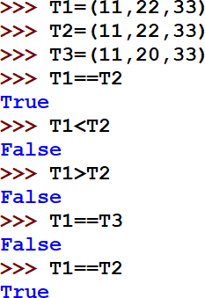
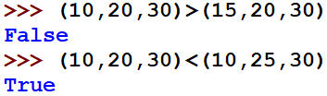
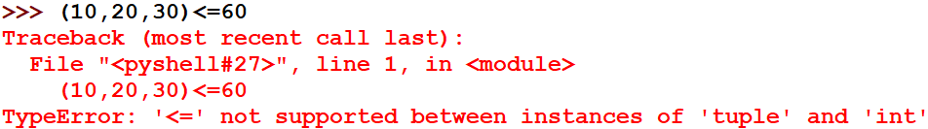
OPERATIONS on Comparison of Tuple
CONTENTS
Comparison of Tuple returns Boolean True or False.
→Tuples Introduction:
→OPERATIONS
ON Tuple
Concatenation/Joining Repetition/ Replication
Membership in Tuple
Comparison of Tuples
→Functions/methods
→ Tuples Slicing;
→ Nested Tuples;
→finding the maximum,
minimum, mean
→ linear search on Tuple
→ counting the frequency
Relational operators
==,!=,<,<=,>,>= are used in comparing two objects.
Here, for example two Tuple objects are compared.
Relational operators ==,!= can be used in comparing two objects eg. Tuple with number/string/tuple. But, Relational operators
<,<=,>,>= always returns ERROR when used in comparing two objects eg.
Tuple with number/string/tuple.
Eg. Tuple CANNOT be
compared with a number

Slide 17














Slide 18
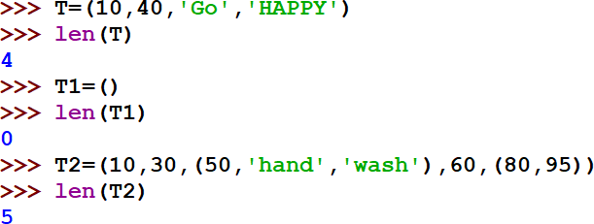

Functions / Methods on Tuple-len()
CONTENTS
len() function counts the no. of elements in the Tuple
→Tuples Introduction:
→Operations on a Tuple
→Functions/ methods
len(), tuple(), count(),
index(), sorted(),min(), max(), sum()
→ Tuples Slicing;
→ Nested Tuples;
→finding the maximum,
minimum, mean
→ linear search on Tuple
→ counting the frequency
TOTAL 5 elements of the Tuple object

Slide 19
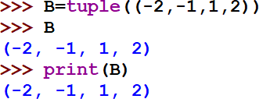
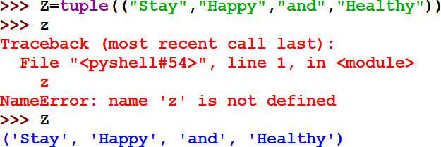
Functions / Methods on Tuple-tuple()
CONTENTS
The tuple() function creates a Tuple object. A Tuple object is a collection which is ordered and changeable.
 | tuple() function takes elements/values inside the parantheses i.e. ()
→Tuples Introduction:
→Operations on a Tuple
→Functions/m ethods
len(), tuple(),
count(), index(), sorted(),min(), max(), sum()
→ Tuples Slicing;
→ Nested Tuples;
→finding the maximum,
minimum, mean
→ linear search on Tuple
→ counting the frequency
NOTE: Python language is case-sensitive.
Here, Z is the Tuple object , so, z in small letters gives an error.

Slide 20
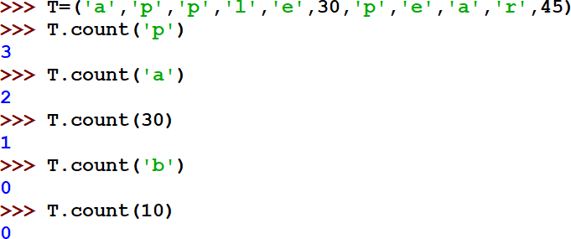
Functions / Methods on Tuple- count()
CONTENTS
count( ) method,
returns the count of the item (no. of times the item /element/value appears) that is passed as argument. If the given item is not in the Tuple, it will return 0
→Tuples Introduction:
→Operations on a Tuple
→Functions/ methods
len(), tuple(),
count(), index(),
sorted(),min(), max(), sum()
→ Tuples Slicing;
→ Nested Tuples;
→finding the maximum,
minimum, mean
→ linear search on Tuple
→ counting the frequency

Slide 21
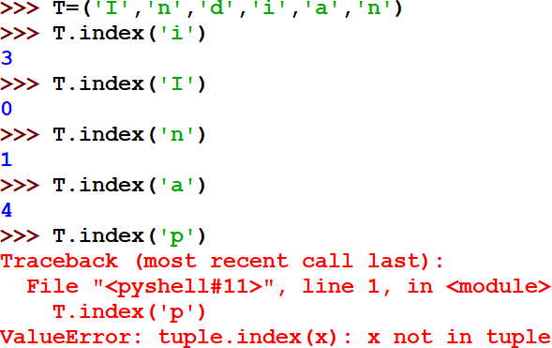
Functions / Methods on Tuple- index()
CONTENTS
index( ) method, returns the index of the first matched item in the Tuple
→Tuples Introduction:
→Operations on a Tuple
→Functions/ methods
len(), tuple(), count(),
index(), sorted(),min(),
max(), sum()
→ Tuples Slicing;
→ Nested Tuples;
→finding the maximum,
minimum, mean
→ linear search on Tuple
→ counting the frequency
Forward Index→
0 1 2 3 4 5

Slide 22
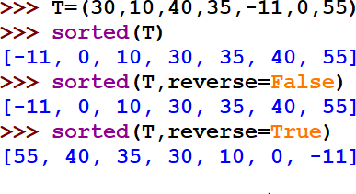

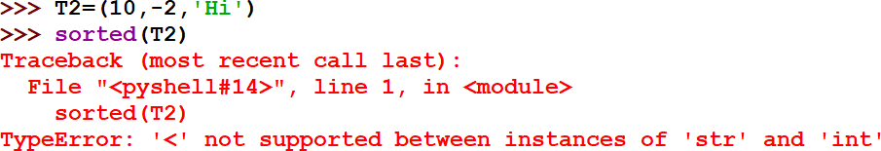
Functions / Methods on Tuple- sorted()
CONTENTS
sorted( ) method,
sorted( ) method and sorted(reverse=True) sorts or orders the items of the Tuple, by default in increasing order. sorted(reverse=True ) for getting the Tuple in decreasing order
→Tuples Introduction:
→Operations on a Tuple
→Functions
/ methods
len(), tuple(), count(), index(), sorted()
,min(), max(), sum()
→ Tuples Slicing;
→ Nested Tuples;
→finding the maximum, minimum, mean
→ linear search on Tuple
→ counting the frequency
NOTE: The sorted( ) method won’t be able to sort the values of a Tuple if it contains complex numbers/tuple / mixed datatype as its elements.

Slide 23
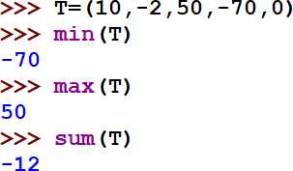
Functions / Methods on Tuple- min(),max(),sum()
CONTENTS
min( ) method,
Returns the minimum out of the elements/values/items of the given Tuple
→Tuples Introduction:
→Operations on a Tuple
→Functions/ methods
len(), tuple(), count(),
index(), sorted(),min(), max(), sum()
→ Tuples Slicing;
→ Nested Tuples;
→finding the maximum,
minimum, mean
→ linear search on Tuple
→ counting the frequency
max( ) method,
Returns the maximum out of the elements/values/items of the given Tuple
sum( ) method,
Returns the sum of all the values/elements/items of the given Tuple.

Slide 24
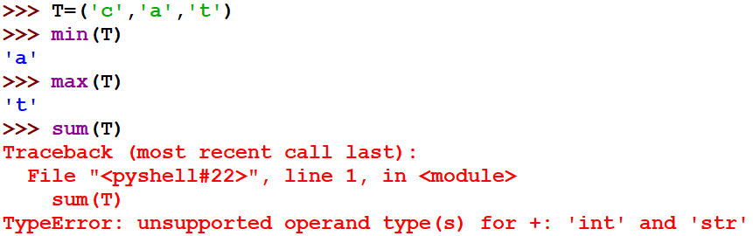


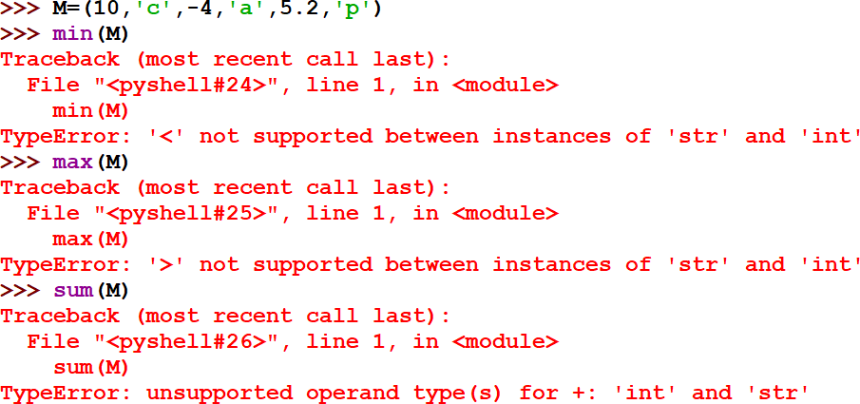











Functions / Methods on Tuple- min(),max(),sum() contd..
Tuple of string . Maximum and Minimum is done on the basis of the ASCII values of the characters from the beginning.
Eg. ‘A’=65, ‘a’ = 97, ‘b’=98 and
so on
A Tuple with mixed data type cannot return values for the min, max and sum functions.

Slide 25
NOTE
Unlike a List object,
an object of Tuple do not have the following methods:
Reverse()
Append()
Extend()
Clear()
Remove()
Pop()

Slide 26




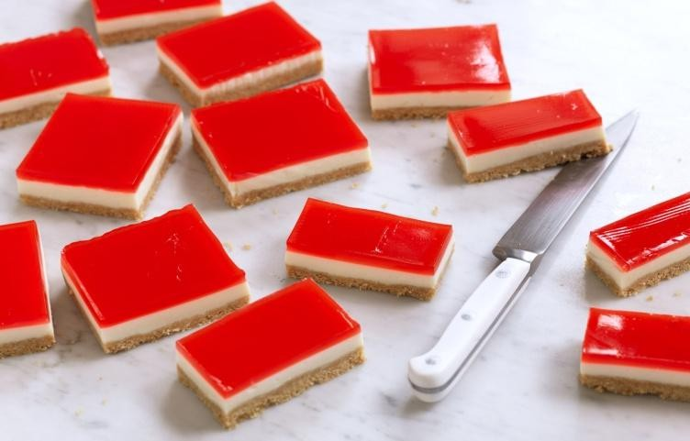


Slide 27
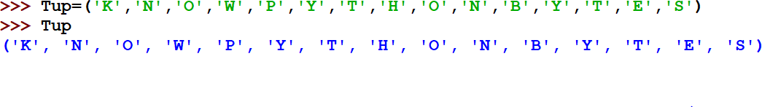
Tuple slicing
L[start:stop] creates a Tuple slice out of Tuple T with elements falling between indexes start and stop, not including value at the stop index.
L[start:stop:step] creates a Tuple slice out of Tuple T with elements falling between indexes start and stop, not including value at the stop index, and skipping step elements in between.
NOTE: In absence of any start, stop, step values, we have Default start index as the beginning, stop index as the last index and step value as +1.
F O R W A R D
I N D E X
D I R E C T I O N
0 | 1 | 2 | 3 | 4 | 5 | 6 | 7 | 8 | 9 | 10 | 11 | 12 | 13 | 14
K | N | O | W | P | Y | T | H | O | N | B | Y | T | E | S
-15 | -14 | -13 | -12 | -11 | -10 | -9 | -8 | -7 | -6 | -5 | -4 | -3 | -2 | -1
B A C K W A R D
I N D E X
D I R E C T I O N

Slide 28
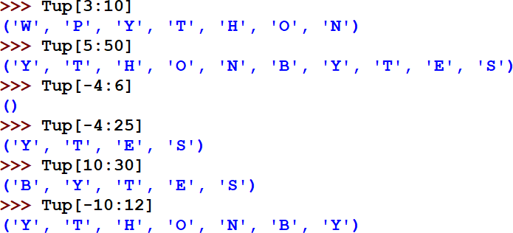
Tuple slicing
0 | 1 | 2 | 3 | 4 | 5 |  | 6 | 7 | 8 | 9 |  | 10 | 11 | 12 | 13 | 14
K | N | O | W | P | Y |  | T | H | O | N |  | B | Y | T | E | S
-15 | -14 | -13 | -12 | -11 | -10 |  | -9 | -8 | -7 | -6 |  | -5 | -4 | -3 | -2 | -1
Start index 3, stop index is (10-1=9)
Start index 5, stop index is 50 which is beyond the last index in forward direction. Hence, it will stop at the last index
Start index -4(backward), stop index is (6-1=5 (forward)). Here, it is not getting any value in the range, hence empty.
Start index -4(which is ‘Y’ as per the backward index,) stop index is 25
which is beyond the last index. Hence, it will stop at the last index.
Start index 10, stop index is 30 which is beyond the last index in forward direction. Hence, it will stop at the last index
Start index -10(which is ‘Y’ as per the backward index,) stop index is 12- 1=11 (forward indexing). Hence, it will stop at the (stop index-1)., ‘Y’ is at 11 index no.

Slide 29
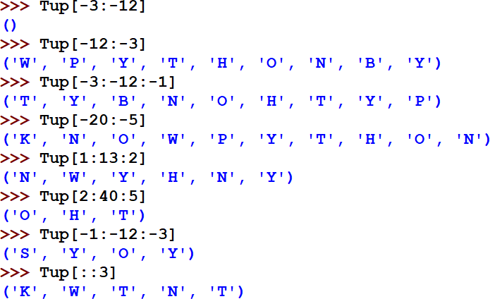

TUPLE SLICING contd.
 | 0 | 1 | 2 | 3 | 4 | 5 | 6 | 7 | 8 | 9 | 10 | 11 | 12 | 13 | 14
 | K | N | O | W | P | Y | T | H | O | N | B | Y | T | E | S
 | -15 | -14 | -13 | -12 | -11 | -10 | -9 | -8 | -7 | -6 | -5 | -4 | -3 | -2 | -1
Start index -3(backward), stop index is -12(backward). Here, it is not getting any value in the range as no step value mentioned in reverse. Hence empty. Start index -12(which is ‘W’ as per the backward index,) stop index is -3 (which takes values till index -3-1= -4) Start index -3(backward), stop index is -12(backward). Here, it is getting value in the range as step value is -1 mentioned in reverse. Start index -20(which is beyond backward index,) stop index is -5 which takes value till (-5-1=-6). Here, -6 is ‘N’. Start index 1, stop index is 13 (till 13-1=12),step value is 2 in forward direction. Hence, it will fetch/take alternate elements with a skip of 1 value in between TRY TO UNDERSTAND YOURSELF. A task for you. ? Also write the slice for Tuple to get the output Default start and stop is beginning and end index of the Tuple. Here, step is 3.
as

Slide 30







Slide 31
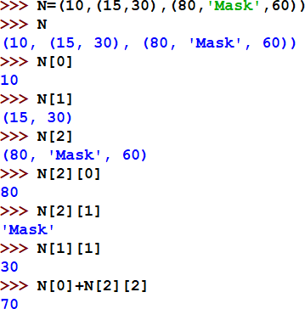
NESTED Tuples
A Tuple within a Tuple is Nested Tuple.
Enclosing Tuple
CONTENTS
→Tuples Intro
→Operations on a Tuple
→Functions/methods
→ Tuples Slicing;
→ Nested Tuples;
→finding the maximum,
minimum, mean
→ linear search on Tuple
Nested Tuple 1
Nested Tuple 2
→ counting the frequency
Note: Denoting Nested elements
using Index nos.
M[0] → 10
M[1] → [15,30]
M[1][0]→15
M[1][1]→30 M[2]→ *80,’Mask’,60+
M[2][0]→80 M[2][1]→‘Mask’ M[2][2]→60

Slide 32






Slide 33
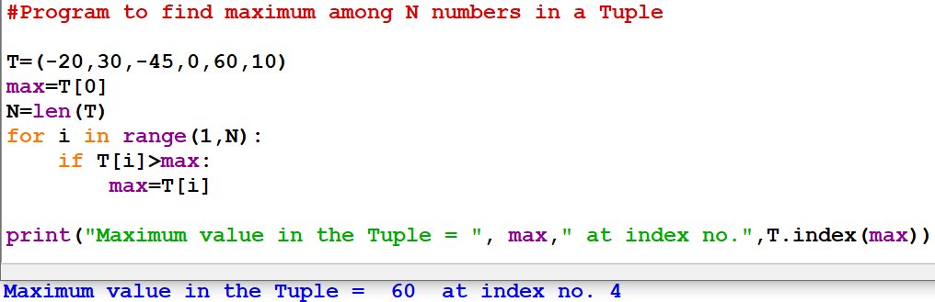
Program to find the MAXIMUM element from a Tuple of element along with its index in the Tuple without using max() library function
CONTENTS
→Tuples Intro
→Operations on a Tuple
→Functions/ methods
→ Tuples Slicing;
→ Nested Tuples;
→finding the
maximum
, minimum, mean
→ linear search on Tuple
→ counting the frequency
NOTE: We are not taking append method as Tuple is immutable. So, declare the tuple beforehand
OUTPUT

Slide 34
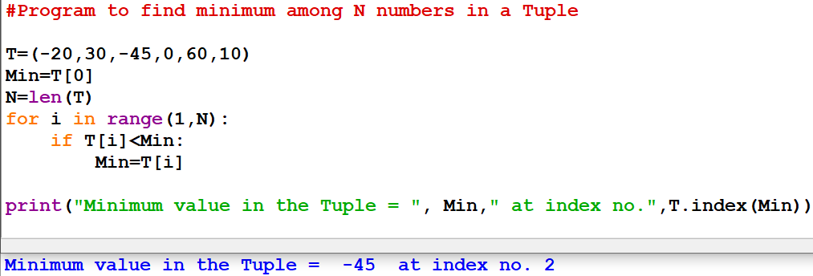
Program to find the MINIMUM element from a Tuple of element along with its index in the Tuple without using min() library function
CONTENTS
→Tuples Intro
→Operations on a Tuple
→Functions/ methods
→ Tuples Slicing;
→ Nested Tuples;
→finding the
minimum,
maximum , mean
→ linear search on Tuple
→ counting the frequency
OUTPUT

Slide 35
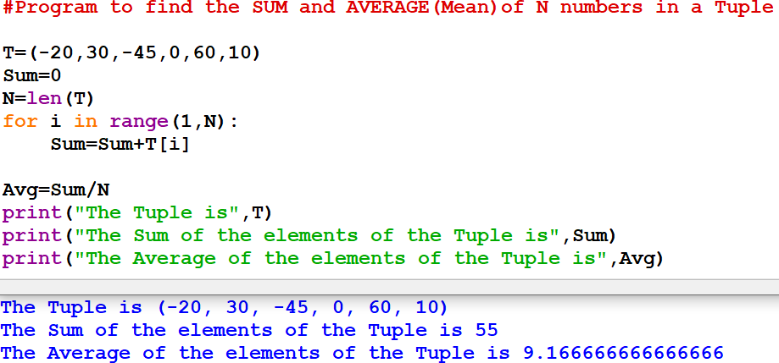
Program to find the MEAN (AVERAGE) of all the elements of the Tuple
CONTENTS
→Tuples Intro
→Operations on a Tuple
→Functions/ methods
→ Tuples Slicing;
→ Nested Tuples;
→finding the mean,
maximum,
minimum
→ linear search on Tuple
→ counting the
frequency
OUTPUT

Slide 36
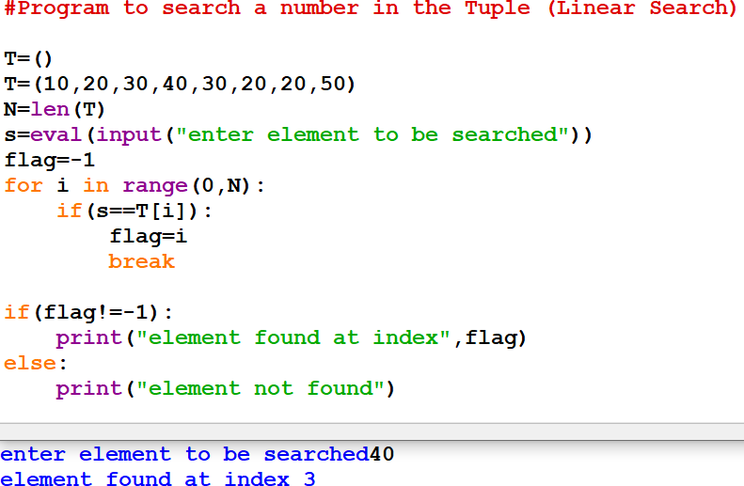
Program to search an element in the Tuple (LINEAR SEARCH)
CONTENTS
→Tuples Intro
→Operations on a Tuple
→Functions/
methods
→ Tuples Slicing;
→ Nested Tuples;
→finding the mean, maximum, minimum
→ linear search on
Tuple
→ counting the frequency
OUTPUT

Slide 37
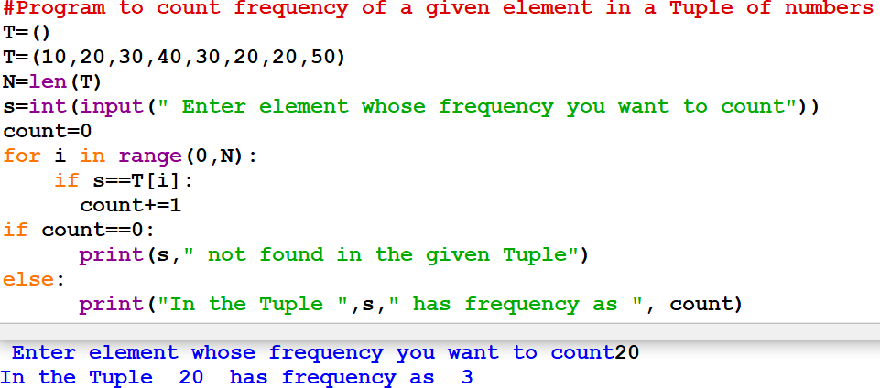
Program to count frequency (/no. of times of occurrence) of an element in the Tuple
(FREQUENCY COUNT)
CONTENTS
→Tuples Intro
→Operations on a Tuple
→Functions/
methods
→ Tuples Slicing;
→ Nested Tuples;
→finding the mean, maximum, minimum
→ linear search on Tuple
→
counting the frequency
OUTPUT

Slide 38
Bibliograhy and References
Google
Wikipedia
XI Computer Science , By Sumita Arora, Dhanpat Rai Publication 2020 Edition
XI Informatics Practices , By Sumita Arora, Dhanpat Rai Publication 2020 Edition

Slide 39
Programming is an ART….
Add your colours to it and make your own

